Slide 1
Are you ready for the tutorial?
Connect to one of GWU’s wireless networks:
GWConnect or Eduroam
Go to the GENI Portal at:
http://portal.geni.net
Notes:
Remember to group Windows users together
Remember to move my .ssh directories, etc.

Slide 2
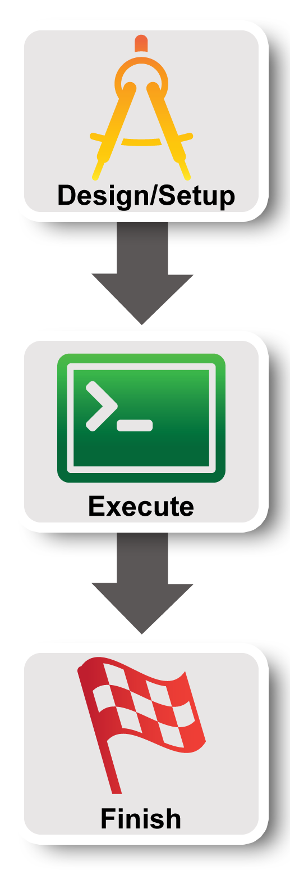
GENI in Education, and Your 1st GENI Experiment
Violet R. Syrotiuk
Arizona State University
Based on a presentation by Sarah Edwards and Vic Thomas, GENI Project Office

Slide 3
Outline
How is GENI being used in education?
Two hands-on exercises:
Create a simple topology and experiment with it
An exercise in Named Data Networking (NDN) using an existing topology

Slide 4
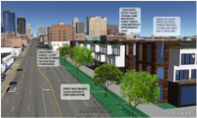
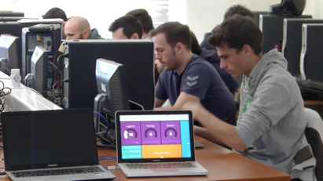
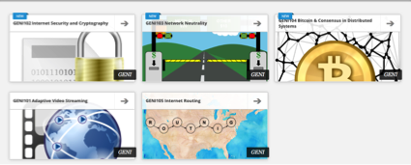
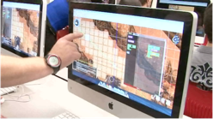
STEM Initiatives using GENI
K-12
Grad/Undergrad
Community
GENI as a remote, virtual lab for classes in:
computer networking,
distributed systems,
cloud computing, and
wireless communications
GENI based Massive Open Online Courses (MOOCs) for the masses
PlanIT: SimCIty like game set
in students’ own city
Bringing scientific instruments
into the classroom virtually
Immersive 3D environments
for problem solving

Slide 5
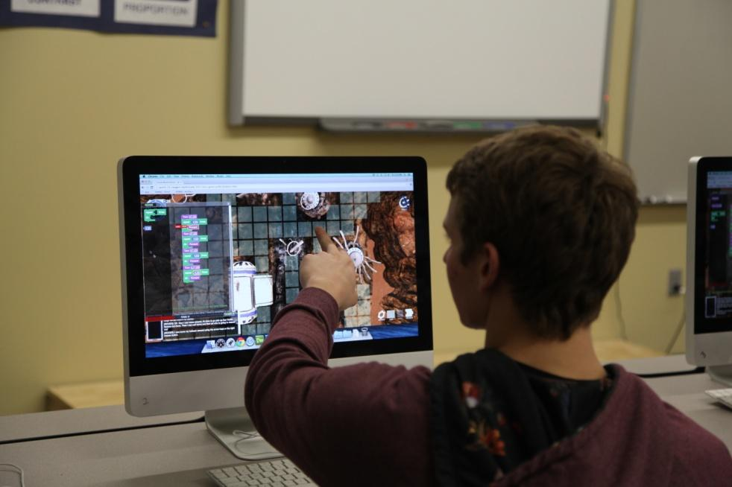

Mars Rover Game
Students at a high school in Colorado learn math and programming using the Mars Rover game
The Mars Rover has crash landed and the student must help the rover repair itself, build shelter, and prepare for colonists before they arrive. The game is designed to engage high school students, effectively teach and assess their critical thinking, math, and programming skills. - https://www.adlnet.gov/mars-game

Slide 6
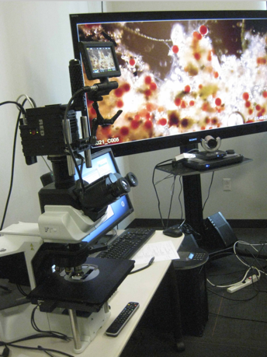
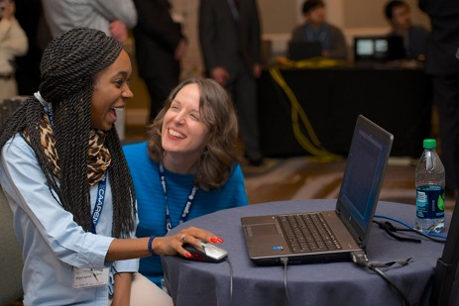
Bringing Science to Life
GENI network
High school student in Chattanooga, TN
Digital cinema microscope
at the U. of Southern California

Slide 7
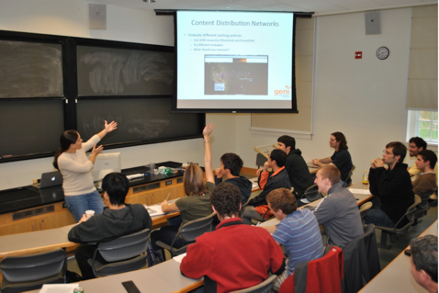

GENI as a Remote Lab
Over 4500 students
have used GENI in
classes taught by 73
instructors
In one semester, 638 students in 24 classes did labs on GENI
Jennie Albrecht teaches a distributed systems class at Williams College, MA
Students using GENI in a
wireless networking class in Greece

Slide 8
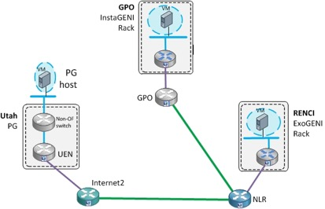
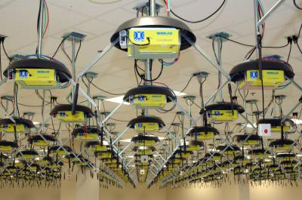
Why use GENI for Education?
No need to acquire and maintain expensive lab facilities
24x7 access from almost anywhere
Enables new lab exercises
Exercises based on expensive and uncommon resources
LTE wireless base stations, long haul network links, programmable switches
Promotes exploratory learning
If student messes up a resource configuration, delete and start over
No instructor or administrator intervention needed
Shared community resource
Community developed course modules
Community supported mailing lists
Wide area experiment on GENI
One of many wireless resources available for GENI labs

Slide 9
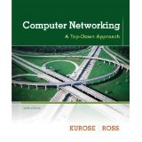
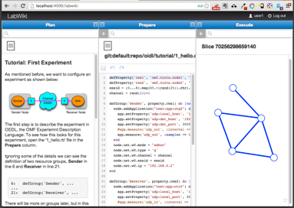
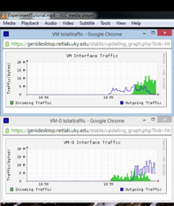
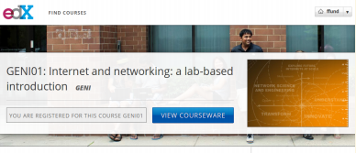
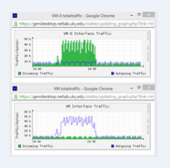

GENI-based Courseware
Labs on GENI for networking textbook
GENI Modules to teach
networking concepts
Mike Zink
UMass Amherst
Example Demo Module
Massive Online Open Courses on GENI
Use GENI to educate the Internet users, not the Internet creators.
Shivendra Panwar, Thanasis Korakis
NYU Poly
Example Assignment
Kevin Jaffay, Jay Aikat
UNC-Chapel Hill

Slide 10
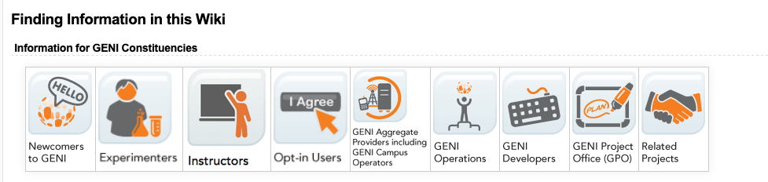
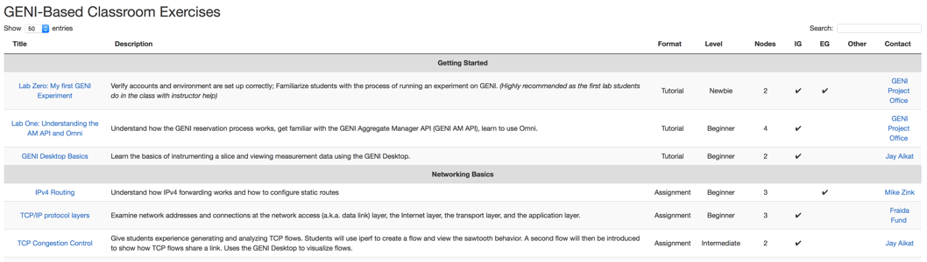
Course Modules on the GENI Wiki
GENI Wiki: https://groups.geni.net/geni

Slide 11
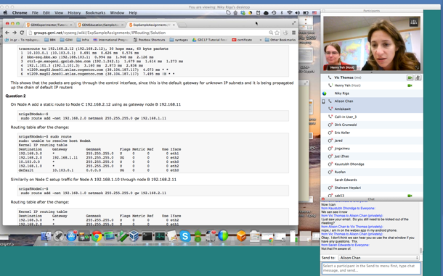
Train-the-TA Webinars
Train the TA webinars offered
Attended by instructors and TAs
Two 3-hour sessions on two afternoons
Session 1: Introduction to GENI
Session 2: Tips for running a class on GENI
Timeline
Set up needed (GENI Project, student accounts, etc.)
Tips for debugging student experiments
Join the community mailing list for educators for announcements:
geni-educators@googlegroups.com

Slide 12
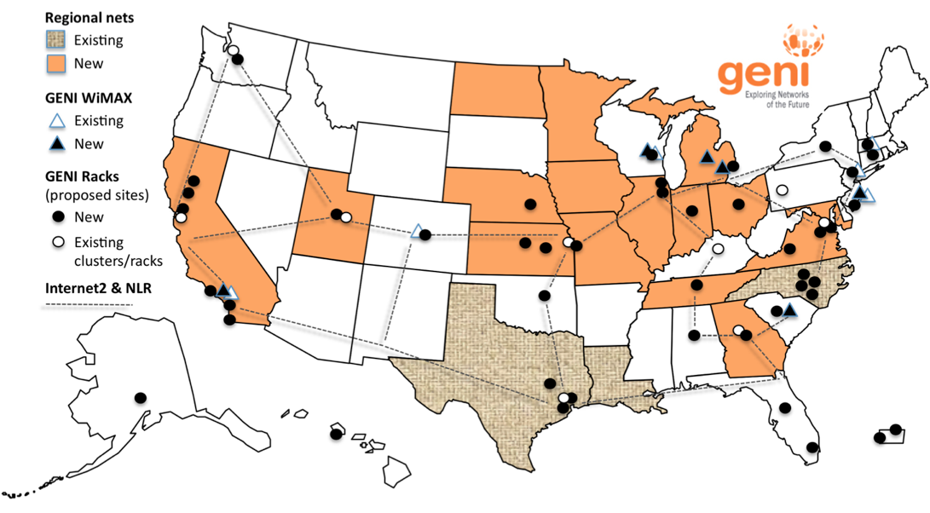
Infrastructure for Experimentation
GENI provides compute resources that can be connected in experimenter specified Layer 2 topologies.
Notes:
GENI is a nationwide suite of infrastructure for “at scale” experiments in networking, distributed systems, security, and novel applications.
GENI opens up huge new opportunities
Leading-edge research in next-generation internets
Rapid innovation in novel, large-scale applications
Key GENI concept: slices & deep programmability
Internet: open innovation in application programs
GENI: open innovation deep into the network

Slide 13
Outline
How is GENI being used in education?
Two hands-on exercises:
Create a simple topology and experiment with it
The purpose of this exercise is to test that your ssh keys are set up correctly
An exercise in Named Data Networking (NDN) using an existing topology
But first, a little terminology…

Slide 14

Experiments run Concurrently
Resources may be virtualized and used by multiple experiments
Experiments live in isolated “slices”

Slide 15
GENI is “Deeply Programmable”
I install software I want throughout my network slice (into routers, switches, …) or control switches using OpenFlow
Everything is programmable: Experimenters create and program custom topologies, protocols and flows
Notes:
Experimenters set up custom:
topologies
protocols
forwarding

Slide 16
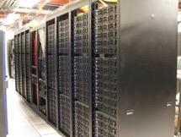
Clearinghouse and Aggregates
Create & Register Slice
users
projects
slices
Slice credentials
clearinghouse
Aggregate Manager (AM) API
- listResources
- createSliver
…
Researcher
Tool
Aggregate
Manager
Aggregate Resources
Clearinghouse: Manages users, projects and slices
Standard credentials shared via custom API or new Common CH API
GENI supported accounts: GENI Portal/CH, PlanetLab CH, ProtoGENI CH
Aggregate: Provides resources to GENI experimenters
Typically owned and managed by an organization
Speaks the GENI AM API
Examples: PlanetLab, Emulab, GENI Racks on various campuses

Slide 17
Resource Specifications (Rspecs)
RSpecs: Lingua franca for describing and requesting resources
“Machine language” for negotiating resources between experiment and aggregate
Experimenter tools eliminate the need for most experimenters to write or read RSpec
<?xml version="1.0" encoding="UTF-8"?>
<rspec xmlns="http://www.protogeni.net/resources/rspec/2"
xmlns:xsi="http://www.w3.org/2001/XMLSchema-instance"
xsi:schemaLocation="http://www.protogeni.net/resources/rspec/2
http://www.protogeni.net/resources/rspec/2/request.xsd"
type="request" >
<node client_id="my-node"
exclusive="true">
<sliver_type name="raw-pc" />
</node>
</rspec>
RSpec for requesting a single node

Slide 18

Reserving Resources using RSpecs and the AM API
Experimenter tools and aggregates talk to each other using resource specifications (RSpecs) and the GENI Aggregate Manager API (GENI AM API)
Advertisement RSpec: What does an aggregate have?
Request RSpec: What does the experimenter want?
Manifest RSpec: What does the experimenter have?
What do you have?
I have …
ListResources(…)
I would like …
Advertisement RSpec
You have …
CreateSliver(Request RSpec, …)
Aggregate
Manager
What do I have?
Experimenter
Tool
Manifest RSpec
You have …
ListResources(SliceName, …)
Manifest RSpec

Slide 19

Hands On Exercises
Experiment #1 in GENI
Reserve two VMs connected at Layer 2
VM
VM
Layer 2
Notes:
There are three goals for today ….
First, jump right in and use GENI to do a very simple (layer 2) experiment

Slide 20
Tutorial Tips
Cut-and-paste is your friend!
Cut-and-paste URLs, commands, etc., from instructions into text boxes, terminal windows
If at any step you don’t understand why you are doing something, ask!
If you fall behind, let us know!
We will help you catch up

Slide 21
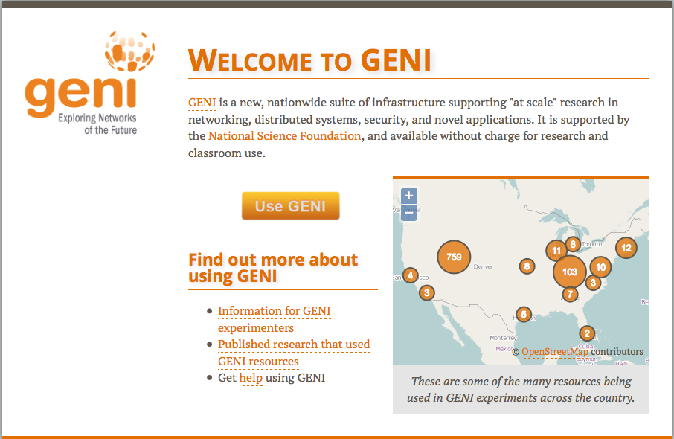
Use the GENI Portal and Jacks
http://portal.geni.net
Notes:
The second goal is to learn how to use the GENI Experimenter Portal and …
The third goal is to use Jacks to reserve resources for this experiment in GENI.
Note that the portal and Jacks are built with GENI in mind so they reflect GENI terminology and concepts.

Slide 22

The GENI Portal is…
A web-based tool for experimenters to manage experimenters, projects, and slices
Includes simple tools to reserve resources
Among other things!
Notes:
The GENI Experimenter Portal is fundamentally about managing experimenters, projects and slices (we’ll define these terms in a minute). But it also has tools for doing resource reservation.
(Note that new tools are being integrated with the Portal all the time.)

Slide 23
Establish Management Environment
Establish the environment
Pre-work: Create a GENI account
Pre-work: Ask to join a project
Project Name: MERIF2019
Generate and download ssh keypair
Click on SSH Keys drop-down menu under “Your Name”
Notes:
First, if you haven’t already, we’ll log into the GENI Portal.
Second, the project lead should have already added you to a project.
Third, we will generate and download an SSH keypair.

Slide 24
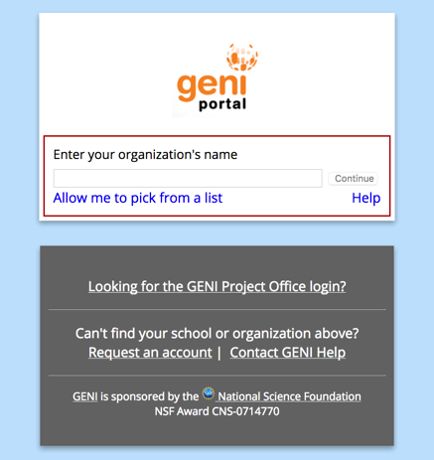
Ready?
Login to the GENI Portal
Check if your institution is listed on the Portal
If so, log in using your university username/password
Otherwise
Request an account from the NCSA
Joined the GENI project for the workshop
Click Home➔Projects➔Join a Project
The project is MERIF2019

Slide 25
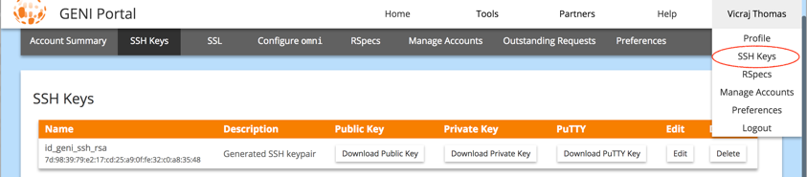
Set?
Create your ssh keys
Look for SSH Keys under your name
Download your ssh private key
Mac/Linux:
Move key to .ssh folder
mv ~/Downloads/id_geni_ssh_rsa ~/.ssh/.
Change permission so only you can read it and add to keychain
chmod 600 ~/.ssh/id_geni_ssh_rsa
ssh-add ~/.ssh/id_geni_ssh_rsa
Windows:
PuTTY download: http:www.putty.org
Download your PuTTY key

Slide 26
Obtain Resources
slice
VM1
VM2
Layer 2
Create a slice
Call it “exp1-xy” where “xy” are your initials
Reserve two VMs at one aggregate using Jacks
Check whether VMs are ready to be used
Notes:
First, we will create a slice.
Second, we will optionally renew the slice.
Third, we will reserve resources at two aggregates. There is real work happening here as the nodes are reserved.
Fourth, we’ll determine if the virtual machines have booted and are ready for use.

Slide 27
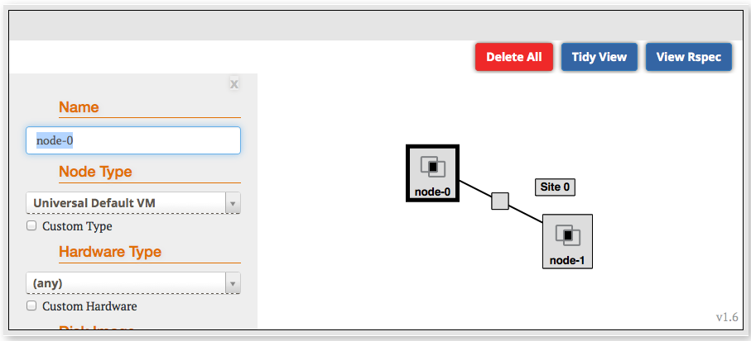
Jacks is…
A graphical user interface (GUI) for:
Designing topologies in GENI
Reserving resources in GENI
In your slice, launch Jacks
Use drag and drop to create the two-node topology
Select an InstaGENI (IG) aggregate to instantiate the resources
Click on the blue reserve button
Notes:
Jacks is a tool that is integrated into the portal which provides a graphical user interface for designing and reserving topologies in GENI.

Slide 28
Execute Experiment
Internet
ssh
Control Interfaces
VM1
Layer 2
VM2
Data Interfaces
Configure and initialize
Wait for the VMs to boot
ssh into the VM1 and VM2 nodes
Notes:
We have two nodes (“client” and “server”) and they each have two interfaces. The control interface connects to the public internet and is the interface you use to login to your nodes. The data interface is what we use for the experiment: it’s connected to the VLAN.
We will log into our nodes.
Then we will run our experiment ….
When we are done we’ll log out.

Slide 29
Execute Experiment
Experimenter
Internet
ssh
Control Interfaces
VM1
Layer 2
VM2
Data Interfaces
Execute experiment
Test connectivity: ping interfaces
Logout of your nodes
Teardown experiment
Delete your resources
Notes:
We have two nodes (“client” and “server”) and they each have two interfaces. The control interface connects to the public internet and is the interface you use to login to your nodes. The data interface is what we use for the experiment: it’s connected to the VLAN.
We will log into our nodes.
Then we will run our experiment ….
When we are done we’ll log out.

Slide 30

Teardown Experiment
project
resource
experimenter
aggregate
slice
When your experiment is done, you should always release your resources
Normally this is when you would archive your data and the experiment
Delete your resources at each aggregate, if >1 used
Notes:
Be sure to delete your resources.

Slide 31
Outline
How is GENI being used in education?
Two hands-on exercises:
Create a simple topology and experiment with it
An exercise in Named Data Networking (NDN) using an existing topology

Slide 32
Named Data Networking (NDN) … also known as Content Centric Networking (CCN)
PRINCIPLE
Focus on what you need, not on where you find it
TODAY
Must know the location of information (aka URL)
Search engines map the what to the where
Most Internet information look-ups start with search engines
NDN (CCN)
New network architecture reflects Internet usage
CCN protocols cache data at all network levels
routers, hosts

Slide 33
Today
Credit: Lixia Zhang talk on “Evolving Internet into the Future via Named Data Networking” at UCLA, Feb 2011.

Slide 34
Credit: Lixia Zhang talk on “Evolving Internet into the Future via Named Data Networking” at UCLA, Feb 2011.

Slide 35
NDN
An implementation of NDN by Xerox PARC
Our exercise uses the NDN software
Software runs on all nodes in our experiment
All nodes cache information that passes through them
When a node gets a data request it:
Returns data from local cache, if available
Passes the request to neighbor if data is not in cache
Caches data returned by neighbor
https://named-data.net/

Slide 36
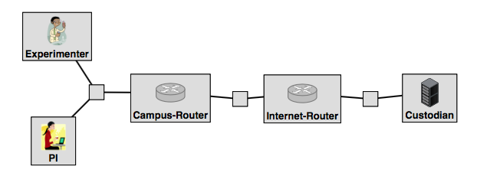
Experiment Setup
The topology has 5 VMs on the same aggregate
Create a new slice: NDN-xy, where xy are your initials
Add resources to the slice:
We don’t have to draw and configure the topology manually
Load the Rspec; copy/paste this URL:
https://raw.githubusercontent.com/GENI-NSF/geni-tutorials/master/LabOne/ndn/lab1-ndn-rspec.xml
Instantiate on an IG rack; click on the blue reserve button

Slide 37
Experiment Setup
Campus-Router
A node that forwards Interest and Data packets to and from the university nodes
Internet-Router
A node that forwards Interest and Data packets to and from the Custodian
Custodian
A data source node that holds data in the namespace
/nytimes
PI and Experimenter
A principal investigator node and an experimenter node at the university that send Interest requests to the Custodian via UDP tunnels

Slide 38
Trying out the NDN Application
Once the topology is up, login to the Custodian node
Run the script in /local/install_script.sh
This will restart the NFD daemon on this node
$ cd /local
$ sudo ./install_script.sh

Slide 39
Run the NDN Application
We are now ready to run our experiment
On the Custodian node, start the producer application
The producer application listens for Interest requests of a namespace -n and replies with Data packets
$ sudo python /local/producer.py -n /nytimes

Slide 40
Run the NDN Application (cont’d)
ssh to the Experimenter node, and start the consumer application
$ sudo python /local/consumer.py -u /nytimes/science
The Interest packet travels the entire topology, leaving breadcrumbs
The Data packet follows the breadcrumbs back to the consumer, leaving cached versions of the content
This is called in-network caching and it is one of the most important features in Information Centric Networking (ICN)

Slide 41
Run the NDN Application (cont’d)
Check this phenomenon by running the same consumer application on the PI node
ssh to the PI node and start the consumer application
$ sudo python /local/consumer.py -u /nytimes/science
This time your PI node gets the content back, but nothing happens on the Custodian because the requested content is cached in the Campus Router node
Note that the Data was retrieved much faster

Slide 42
Run the NDN Application (cont’d)
Repeat the experiment with different namespaces
$ sudo python /local/consumer.py -u /nytimes/math
This time you see that the Interest request is served by the Custodian

Slide 43
Teardown Experiment
project
resource
experimenter
aggregate
slice
As before, when your experiment is done, you should always release your resources
Notes:
Be sure to delete your resources.

Slide 44
Congratulations!
You have…
Run your first GENI experiments!
Exercised your knowledge of GENI terminology
Used the GENI Portal and Jacks
Notes:
When we started, we promised to do three things.
You’ve run your first GENI experiment.
You’ve hopefully developed a more concrete understanding of GENI terminology.
You have used the GENI portal and Jacks

Slide 45
Welcome
to GENI!

